Slide 1

O NL I N E FOOD ORDER
NAME:T JANARDHAN

Slide 2
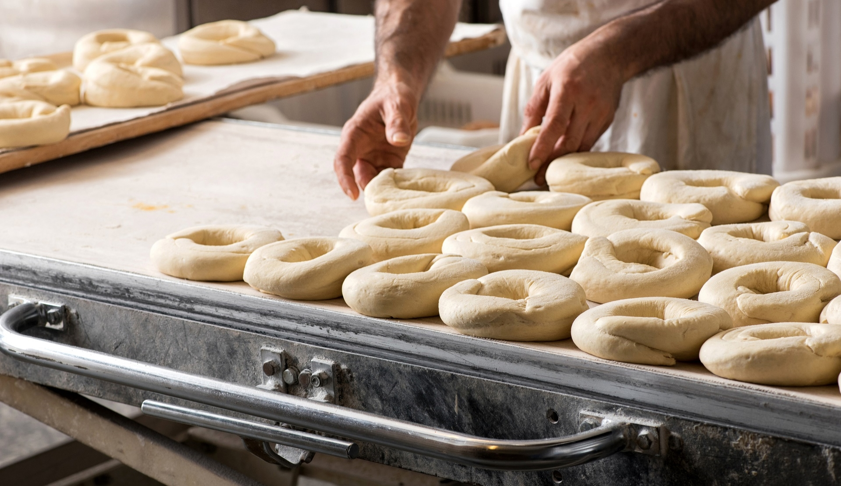
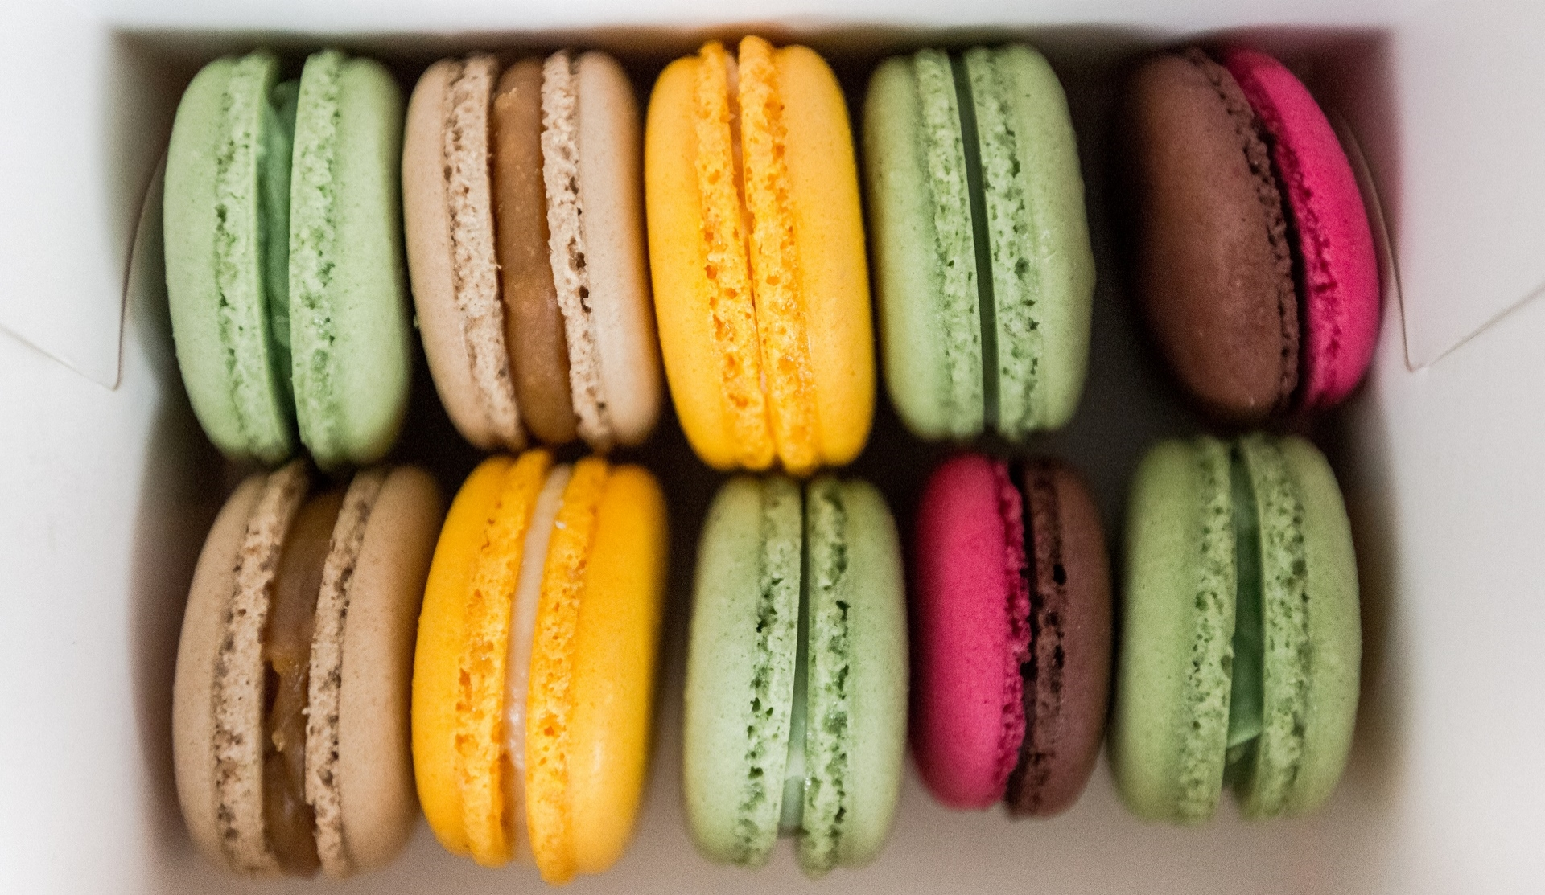
Introduction
With PowerPoint, you can create presentations and share your work with others, wherever they are. Type the text you want here to get started. You can also add images, art, and videos on this template. Save to OneDrive and access your presentations from your computer, tablet, or phone.

Slide 3

REQUIREMENTS:-
SOFT WARE:-
1.MICROSOFT POWER POINT
2.SNIPPING TOOL
3.GOOGLE SLIDES WEBSITE
ETC…
HARD WARE:-
1.DESKTOP CUMPUTER
2.MOBILE
OTHERS:-
FRIENDS,MAM,FAMILY….

Slide 4
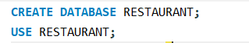
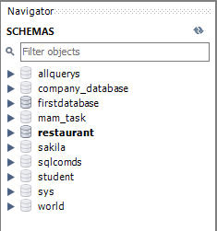
DATA BASE:-
It is used to store all the data, multiple tables to preserve the information.
Create database syntax:-
CREATE DATABASE< database_name > ;
USE <DATABASE_NAME>;
Example:-

Slide 5
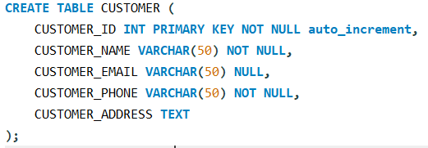
Create table1:-customer

Slide 6
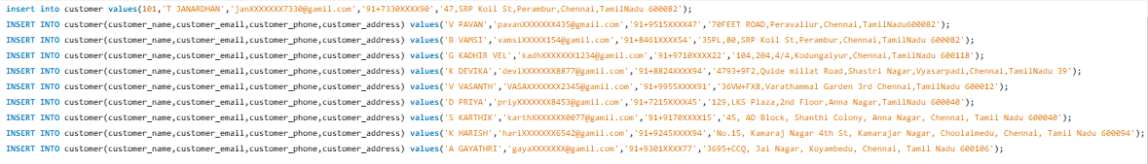
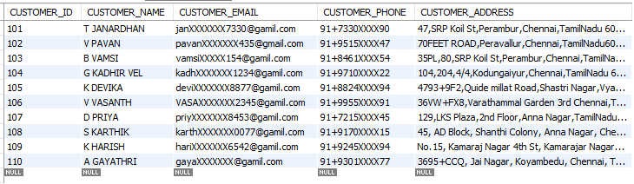
Insert values into customer table:-
Output:-

Slide 7
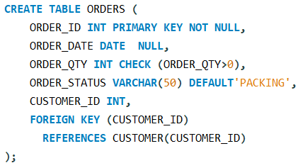
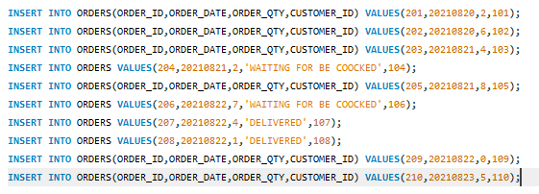
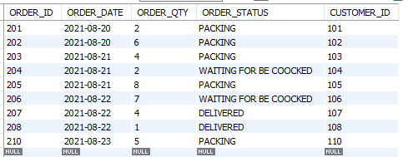
Create table2:-ORDERS
Insert values into ORDERS table:-
Output:-

Slide 8
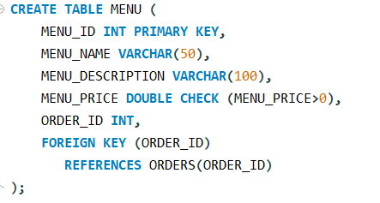
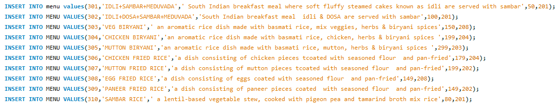
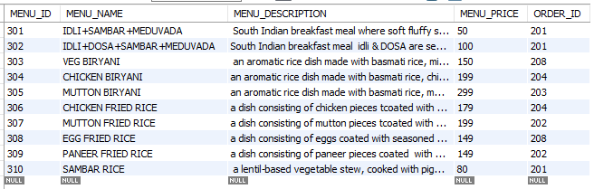
Create table 3:-MENU
Insert values into MENU table:-
Output:-

Slide 9
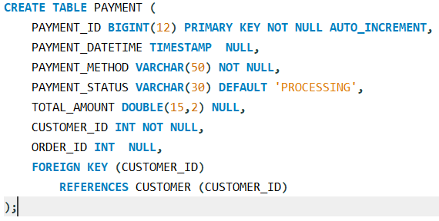
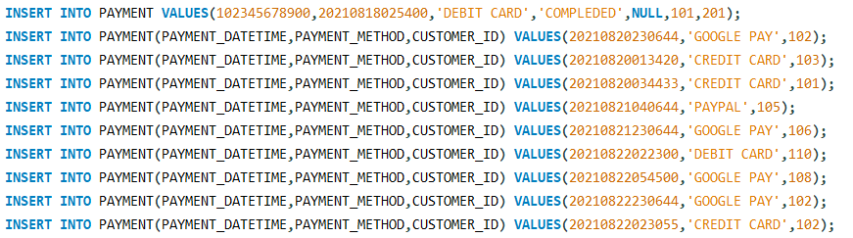
Create table 4:-PAYMENT
Insert values into PAYMENT table:-

Slide 10
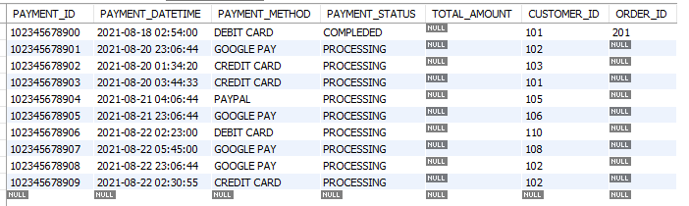
.
Output:-

Slide 11
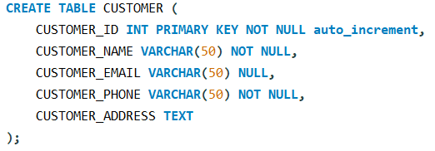
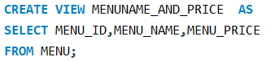
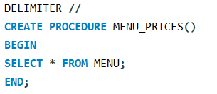
DDL:-DATA DEFINITION LANGUAGE
1.CREATE=TO CREATE A DATABASE,TABLE,VIEW,STORED PROCEDURE

Slide 12
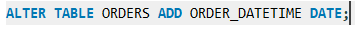
2.ALTER=TO ALTER A TABLE BY ADDING OR DELETING ACOLUMN,
3.RENAME=TO CHANRE THE ORIGINAL NAME OF A TABLE / COLUMN BY GIVING NEW NAME,
4.DROP=TO DELETE THE ENTIRE TABLE.
5.TRUNCATE=TO DELETE ALL THE RECORDS FROM TABLE.

Slide 13
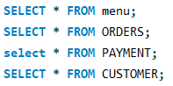
DML :-
D Q L :-

Slide 14
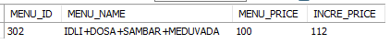
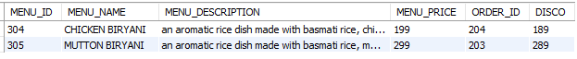
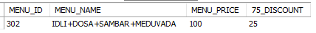
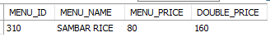
ARITHMETIC OPERATORS

Slide 15
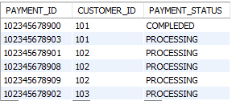
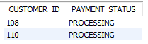
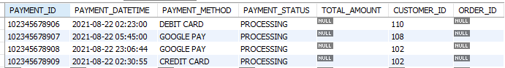
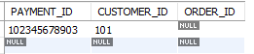
COMPARISON /RELATION OPERATERS

Slide 16
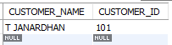
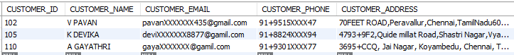
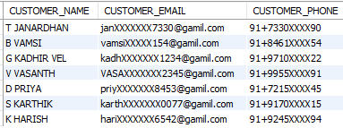
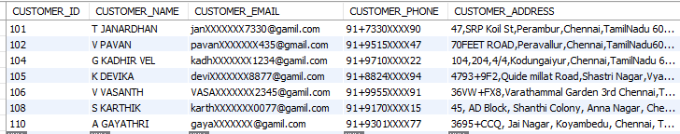
LOGICAL OPERATORS

Slide 17
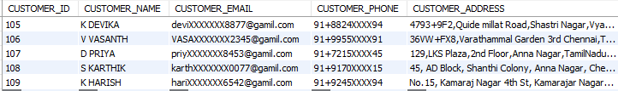
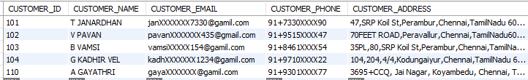
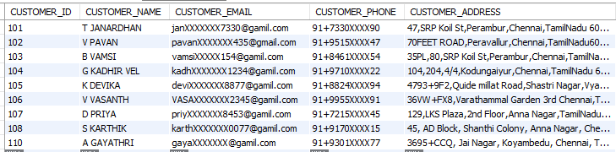

Slide 18
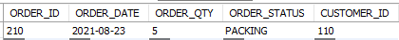
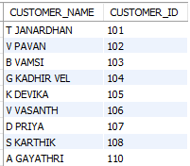
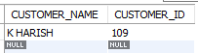

Slide 19
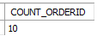
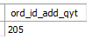
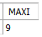
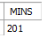
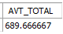
AGGREGATE FUNCTIONS

Slide 20
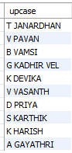
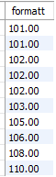
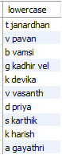
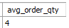
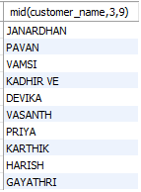
SCALAR FUNCTIONS

Slide 21
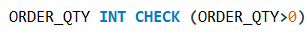

SQL CONSTRAINS

Slide 22


SQL JOINS
INNER JOIN:-
Output:-

Slide 23


LEFT OUTER JOIN :-
Output:-

Slide 24


RIGHT OUTER JOIN
Output:-

Slide 25


CARTESIAN JOIN :- ( CROSS JOIN )
Output:-

Slide 26


SELF JOIN :-
Output:-

Slide 27




SINGLE TABLE VIEW
MULTIPLE TABLE VIEW
Output:-
Output:-

Slide 28




SUB QUERY (SELECT)
SUB QUERY (FROM)
Output:-
Output:-

Slide 29




SUB QUERY (WHERE)
SUB QUERY (UPDATE)
Output:-
SUB QUERY (DELETE)

Slide 30



ORDER BY (ASC):-
Output:-
ORDER BY (DESC) :-
Output:-
GROUP BY :-
Output:-

Slide 31


STORED PROCEDURE:- (WITHOUT PERAMETER)
Output:-

Slide 32


STORED PROCEDURE:- (WITH PASSING INPUT PERAMETER)
Output:-

Slide 33


STORED PROCEDURE:- (WITH PASSING OUTPUT PERAMETER)
Output:-

Slide 34

STORED PROCEDURE:- (WITH PASSING INOUT PERAMETER)

Slide 35






SET OPERATORS
UNION
UNION ALL
INTRSECTS
Output:-
Output:-
Output:-

Slide 36


TRIGGERS

Slide 37



THANK YOU
🙃

